Slide 1
Lost and Found
Bing News Mobile Native Design Exploration

Slide 2
So the problem led my design was “Reading news is boring.” especially for the younger generations.
When talk about reading news, they threw the answers like I read new on Weibo’s popular ranking, or I got news from my Wechat the moments sharing. Some people even is obtaining news topics on Tiktok.

Slide 3
When we talk about the value of design, we always use some positive words like what users could gain from this experience?

Slide 4
But people don’t like to talk about lost.
There is another design opportunity,
What if we could bridge the gap of what they have lost?

Slide 5
is why they less likely reading news.

Slide 6
Pain Points
Lost focus
Lost interests
Lost updates

Slide 7
Lost Focus
Lost focus while reading, thus it would make users feel boring

Slide 9
Lost focus
When do people lost their focus?
What kind of thing could attract their focus?

Slide 10
Reason 1
74% of mobile news app users expect real-time content updates.(1)
When the content is
Not up-to-date
When they emerging in a long reading list, while scrolling down, the content is getting not up-to-date.

Slide 11
Current design
Problem
while reading in the category page or the comprehensive view page, the last part is a long [more related news] section

Slide 12
Of course news is being generated in every second and our algorithm are powerful enough to put them together.
But how to let the users know “now here are the events just happened”., is the problem I try to solve

Slide 13
2 design directions
Refresh current list, from bottom to top
Jump to a new page with new content feed

Slide 14
Idea 1 “light refreshment”
Design 1
Design 2

Slide 15
Design 1 refresh notification
Currently users should at least go back to the first screen to refresh by tapping the top bar or manually going back

Slide 16
Competitors
Refresh feature
Refresh notification
Let users know there are something new when they scrolling down
Reuters has its tiny interactive floating features triggered by small actions, very deep and not frequent, only if I stay in the reading list for a while
Bilibili

Slide 17
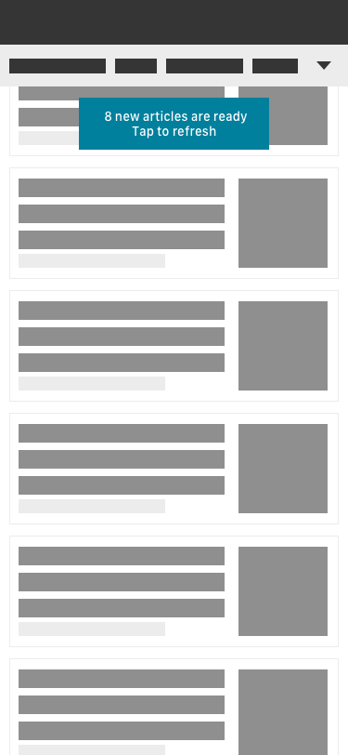
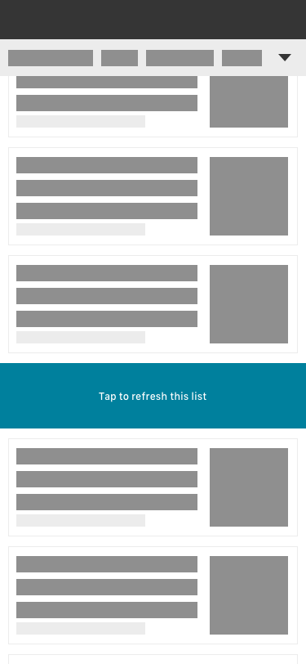
Interaction Design

Slide 18
Design decision and why

Slide 19
Visual Explorations

Slide 20
Pros
It is only triggered when users really scroll down for a while, so it won’t disturb a lot user’s original reading journey
Cons
If in this category or topic don’t have the real-time new article, it won’t trigger
Users only know the number of the new article but don’t know the exact content of them, if tap, they also lost the current reading progress

Slide 21
Idea 1 “light refreshment”
Design 1
Design 2

Slide 22
Design 2 New collection
We actually have the landing page which is the comprehensive view page that is triggered in search result and news list
Is there any opportunity to make this exposing more?

Slide 23
Competitors
Video platforms
recommendation

Slide 24
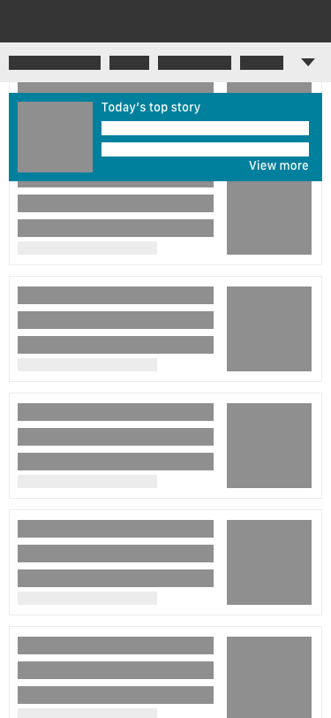
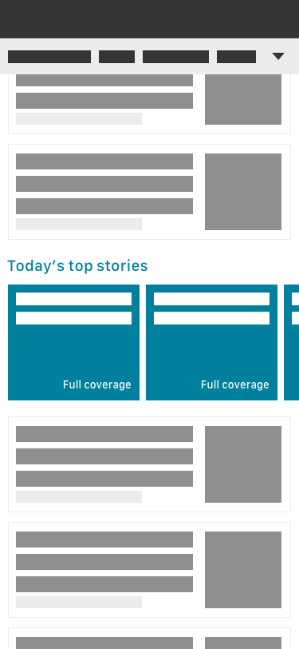
Interaction Design

Slide 25
Visual explorations

Slide 26
Pros
People like image to know a part of the content
When they know the content, it’s easier to attract them.
Cons
If the algorithm is not smart enough, sometimes it may bring confusing topics like not relevant to the current news list

Slide 27
Idea 1 “light refreshment” sbs
Design 1
Design 2

Slide 28
Reason 2
people said they don’t know why the headlines are headlines.)
When the content is
Not impressing
When the content is not breaking( like
Not match their interests

Slide 29
Why they scroll down so quickly is the “top news” are not impressing to them.
So what if we make the top news experience more powerful to make their lost attention back?

Slide 30
User indeed said,
People gravitated towards designs that had larger images, brighter color/designs, immediate customization options, and contextual references. (2)
We’ve know their expectation,

Slide 31
What our competitor doing is
An interactive experience for a more immersive multimedia news digestion

Slide 32
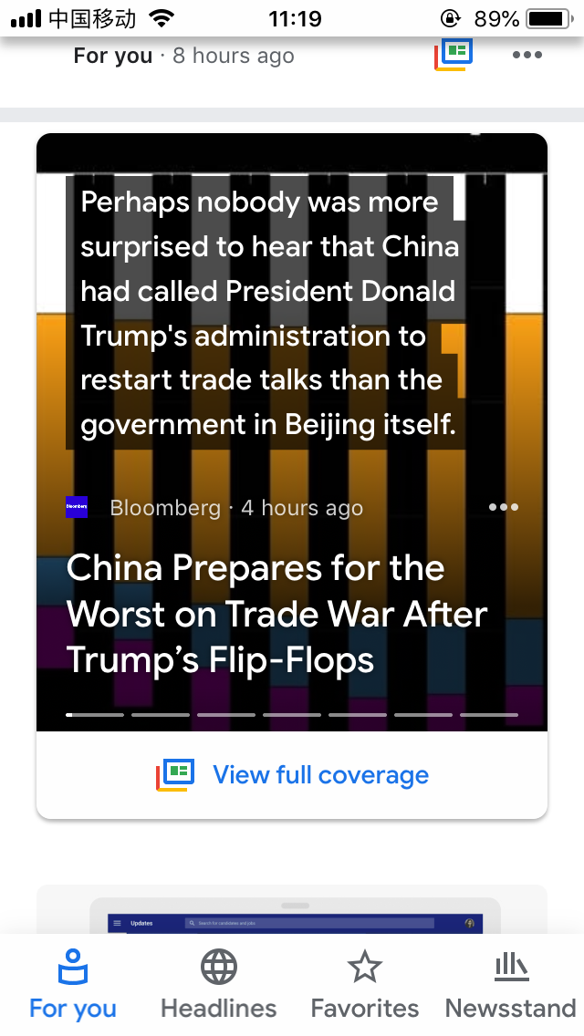
Interactive Experience
News card
Google has its well designed interactions that allows users read various source news of the same event
Including news(Headline, snippets, thumbnail, publisher, published time), social, video, opinion

Slide 33
Idea 2 “attention grabber”

Slide 34
Interaction Design

Slide 35
Visual explorations

Slide 36
But there is another part of this problem, why people lost their focus on our design, may be they couldn’t find the topics they are interested in.

Slide 37
Lost interest
Hard to get personalized content

Slide 38
But wait, when we talk about interesting content to people
We need to figure out what are they interested in
So there are two kinds of interested type
Lower interested: took action: read
The topic people searched
The topic people landed to comprehensive view page and read
Higher interested: they have clear follow-up intention
The topics they followed

Slide 39
Mobile news app users say they want personalized content, but few have taken steps to get it.(1)
Users prefer content to be organized by category/topic (1)
What are the barriers?

Slide 40
We indeed have a gap need to bridge which is the content personalization part on mobile.
We have this function on desktop now, but
Staying up-to-date is the primary reason people use mobile news apps.(1)
Mobile is a better scenario for catch-up their interests.

Slide 41
OA
A easier personalized feed and navigation

Slide 42
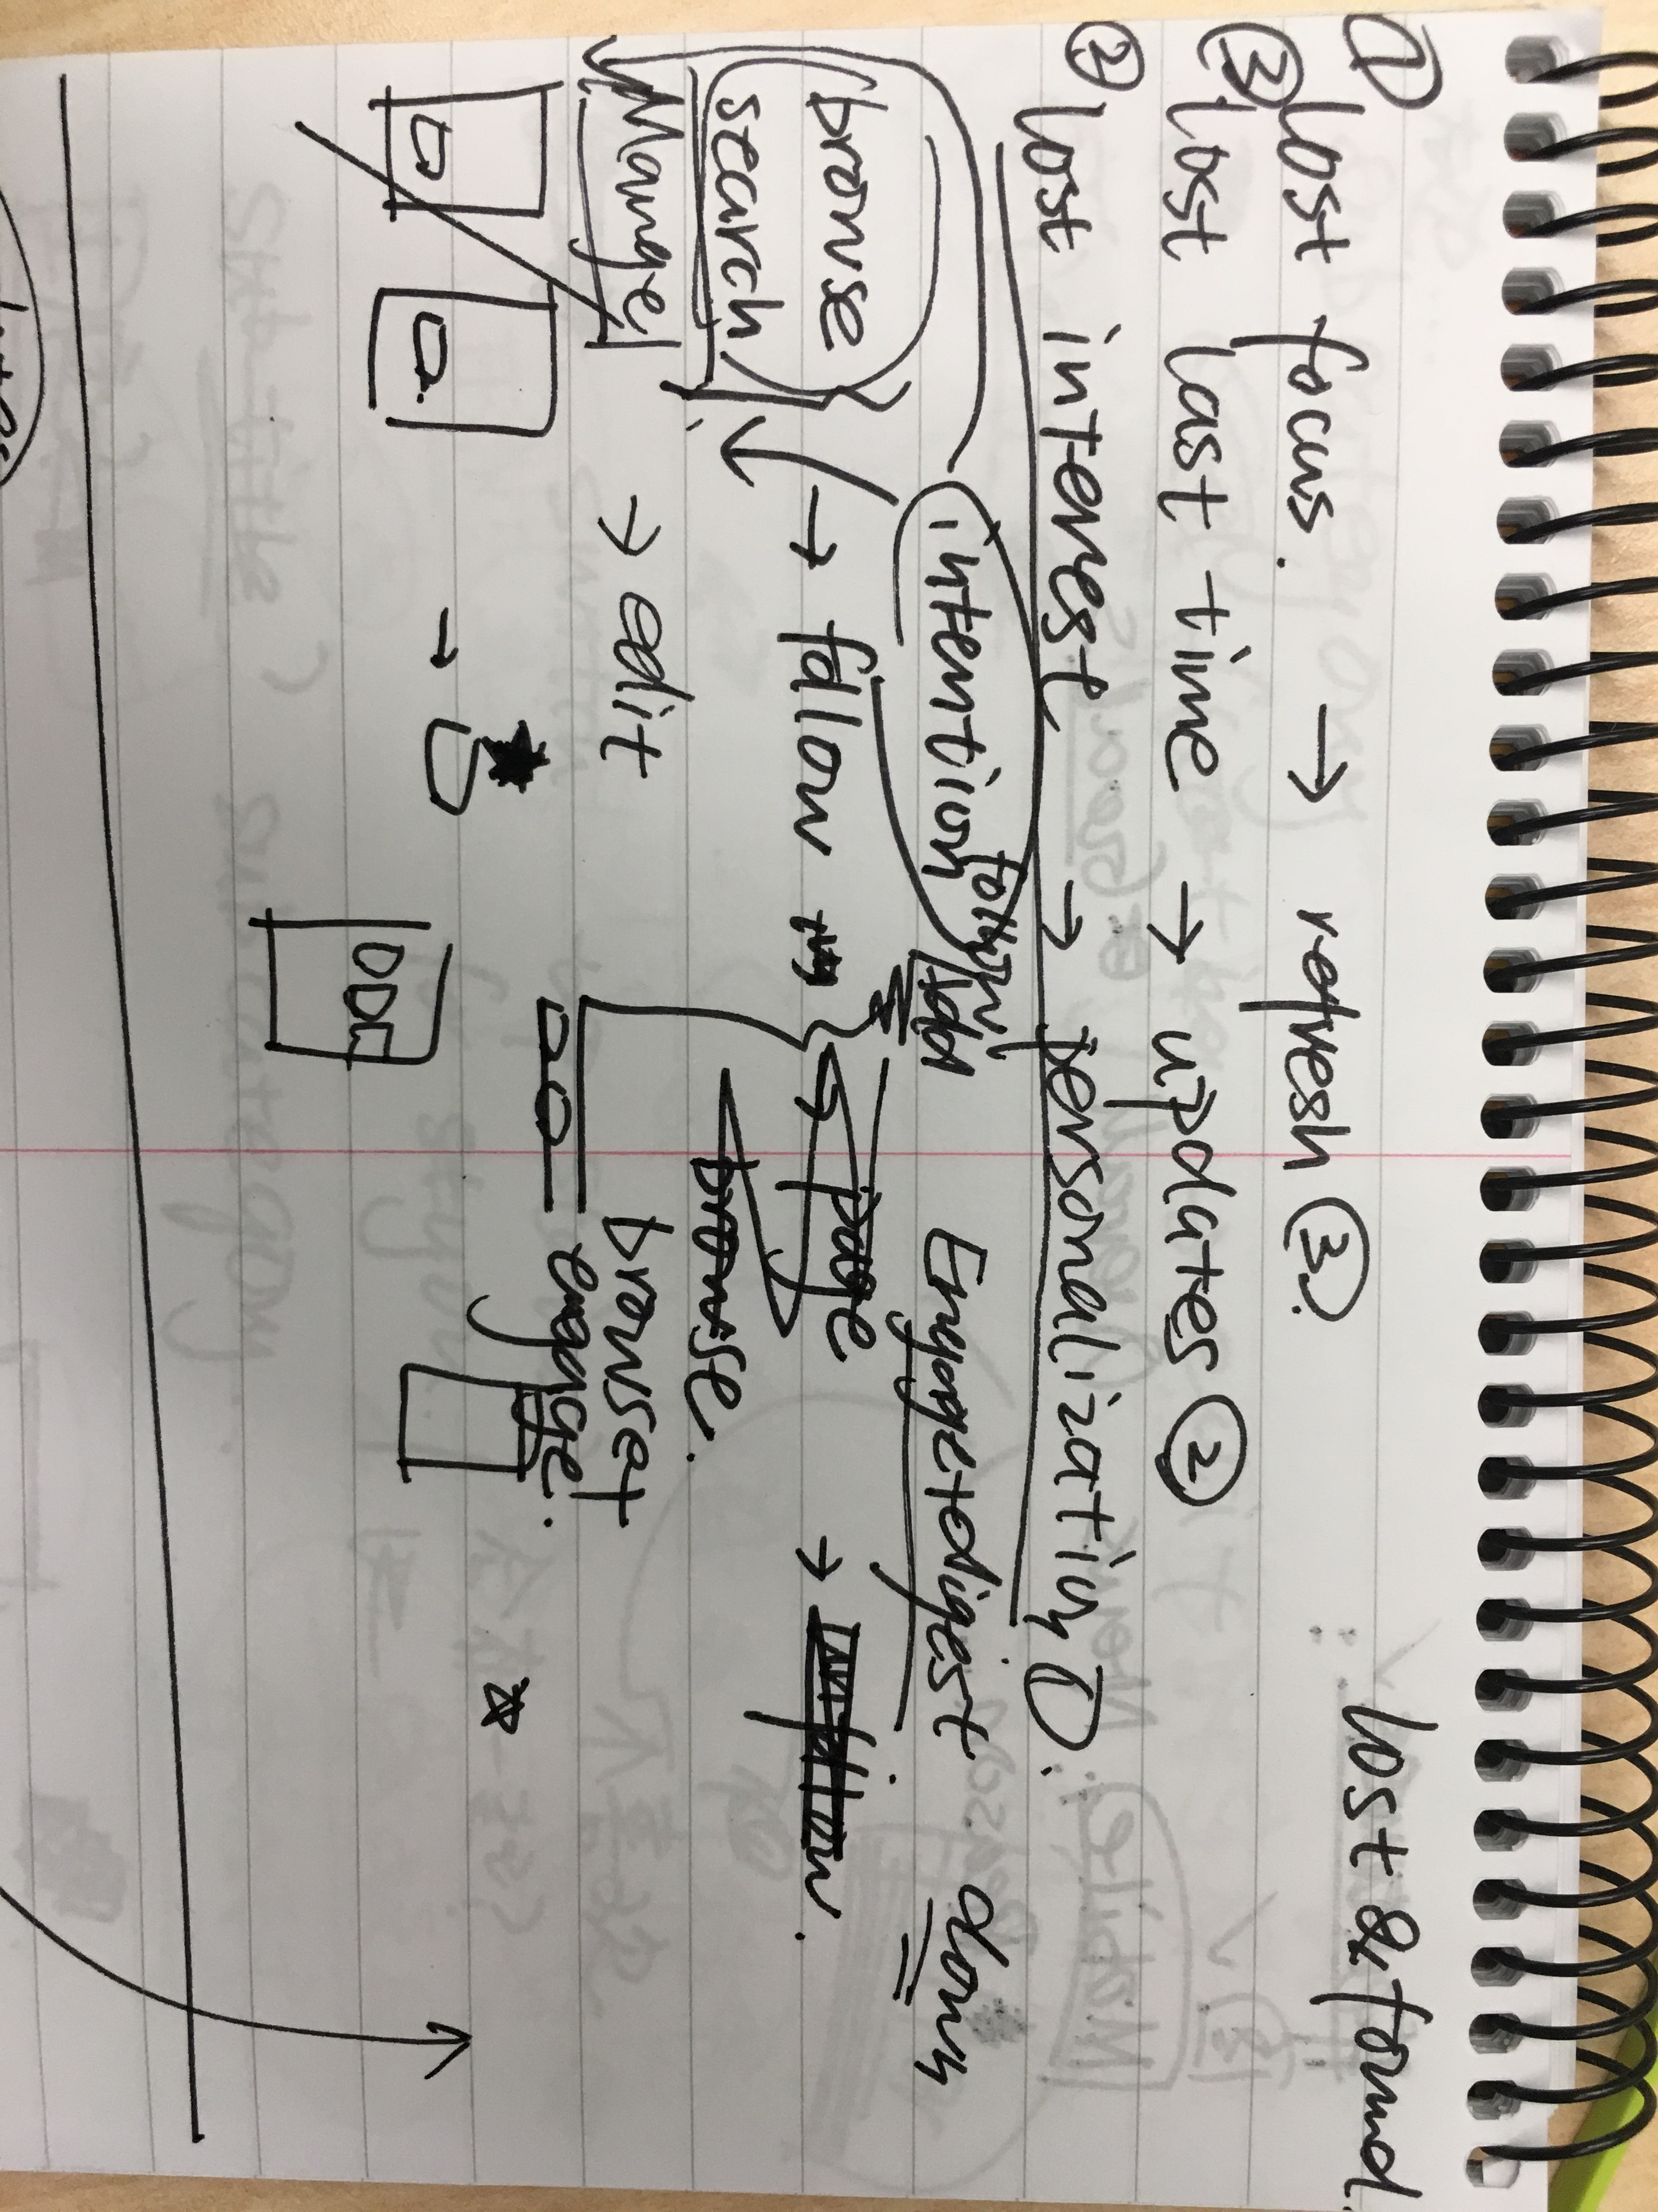
Getting interested journey

Slide 43
User flow

Slide 44
Idea

Slide 45
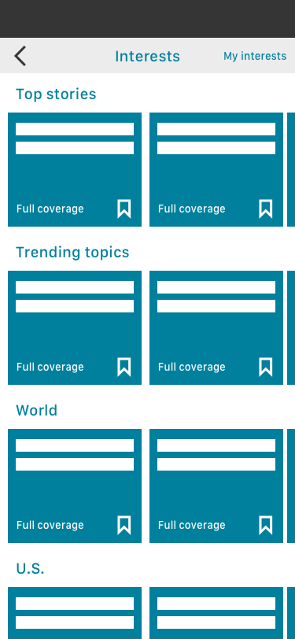
Follow

Slide 46
Current design
Only on desktop, they could manage their interest.
The topic follow button doesn’t make sense to users.(mobile user study 2019)

Slide 47
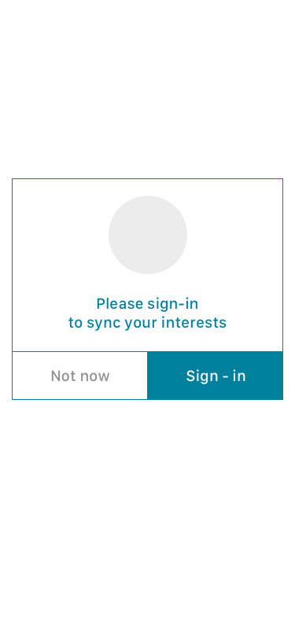

Slide 48
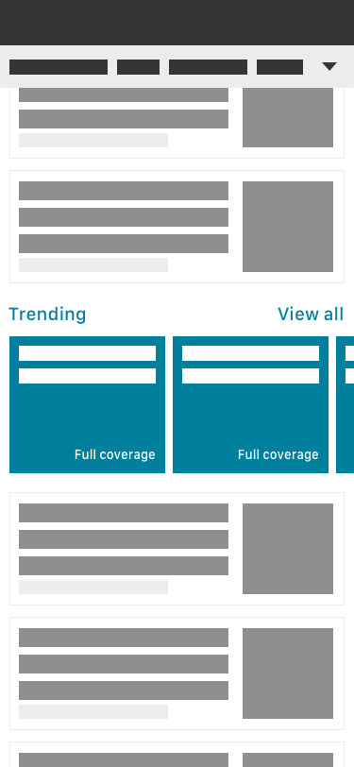
Entry point

Slide 49
Read/Engage

Slide 50
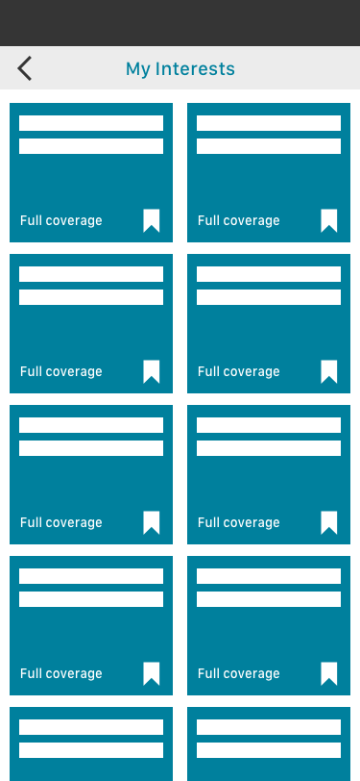
Manage/unfollow

Slide 51
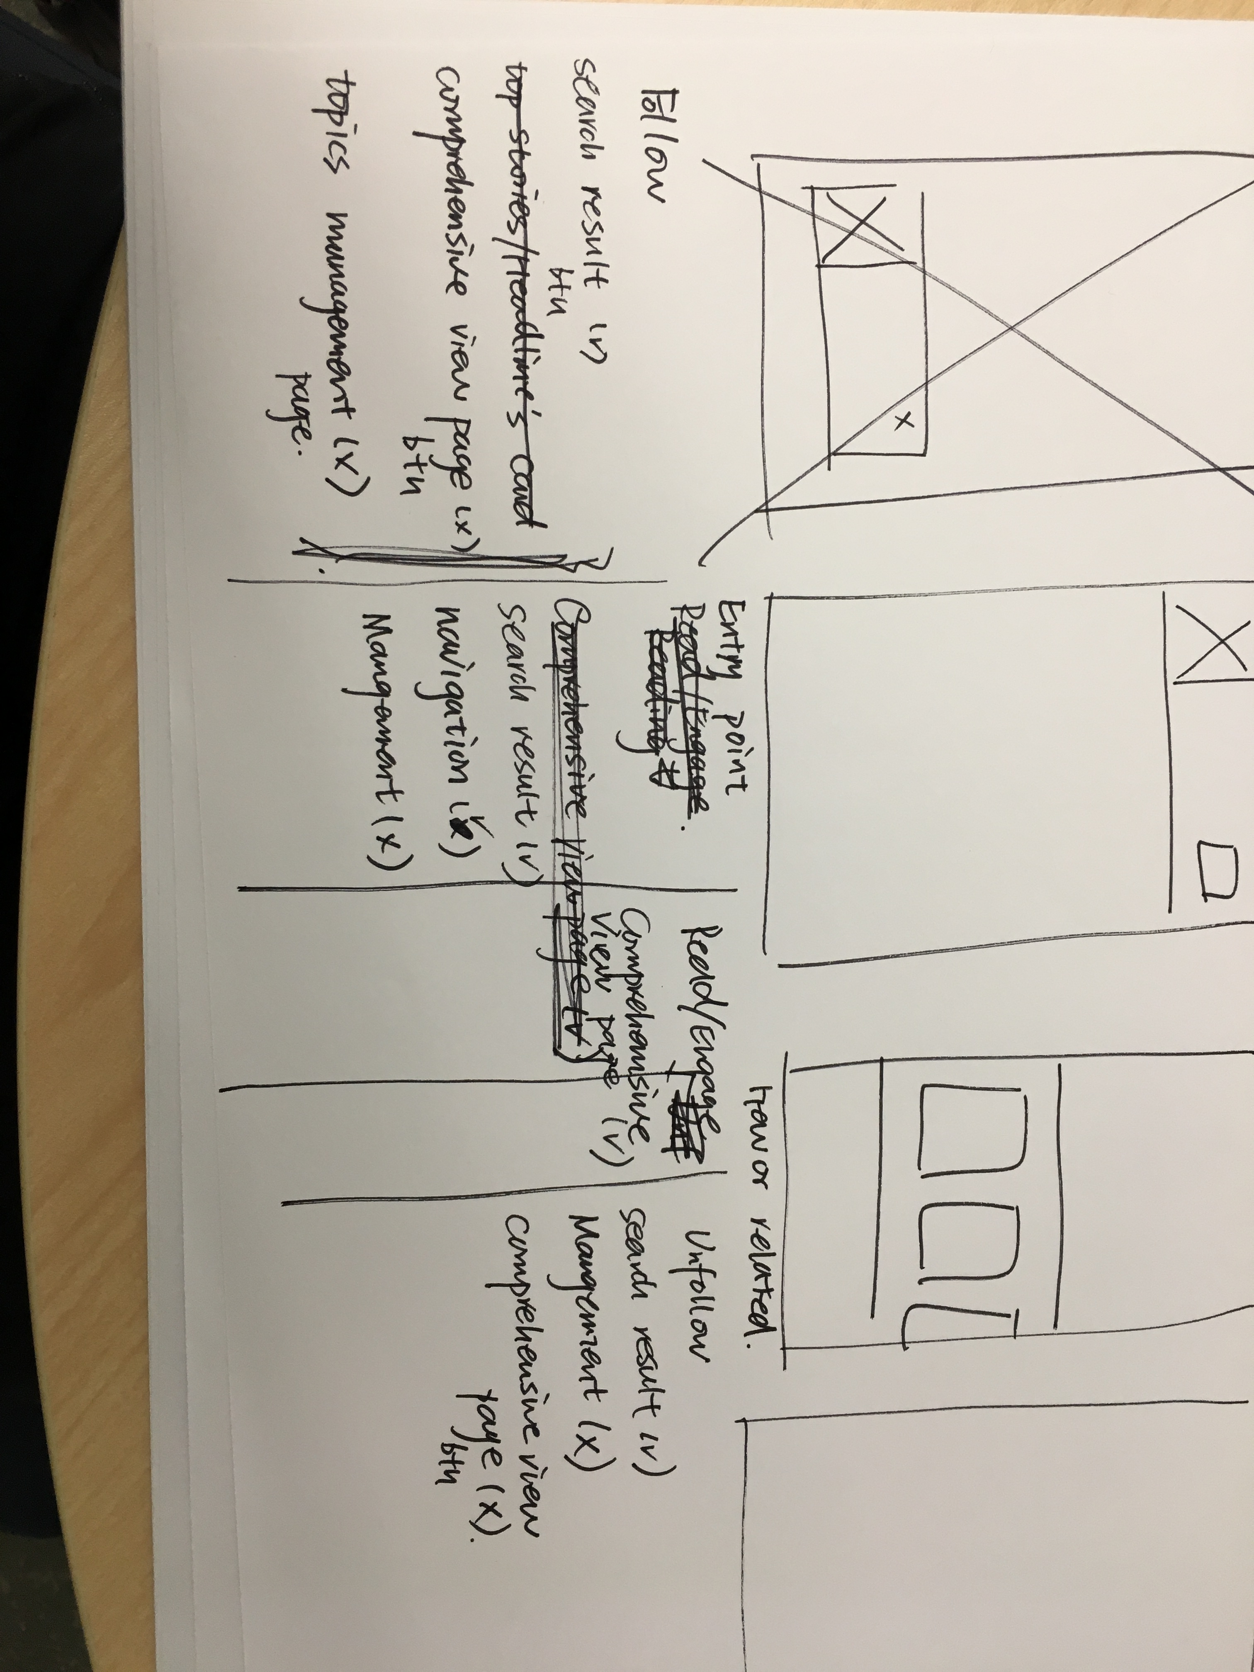
Wireframe

Slide 52
Visual exploration

Slide 53
Since the experience is embedded in the opal app, so the entry point would be less visible if we put this in the setting.
And also the current navigation is less useful for topics since they are on last position of the bar. It takes too much efforts to scroll down to that part.

Slide 54
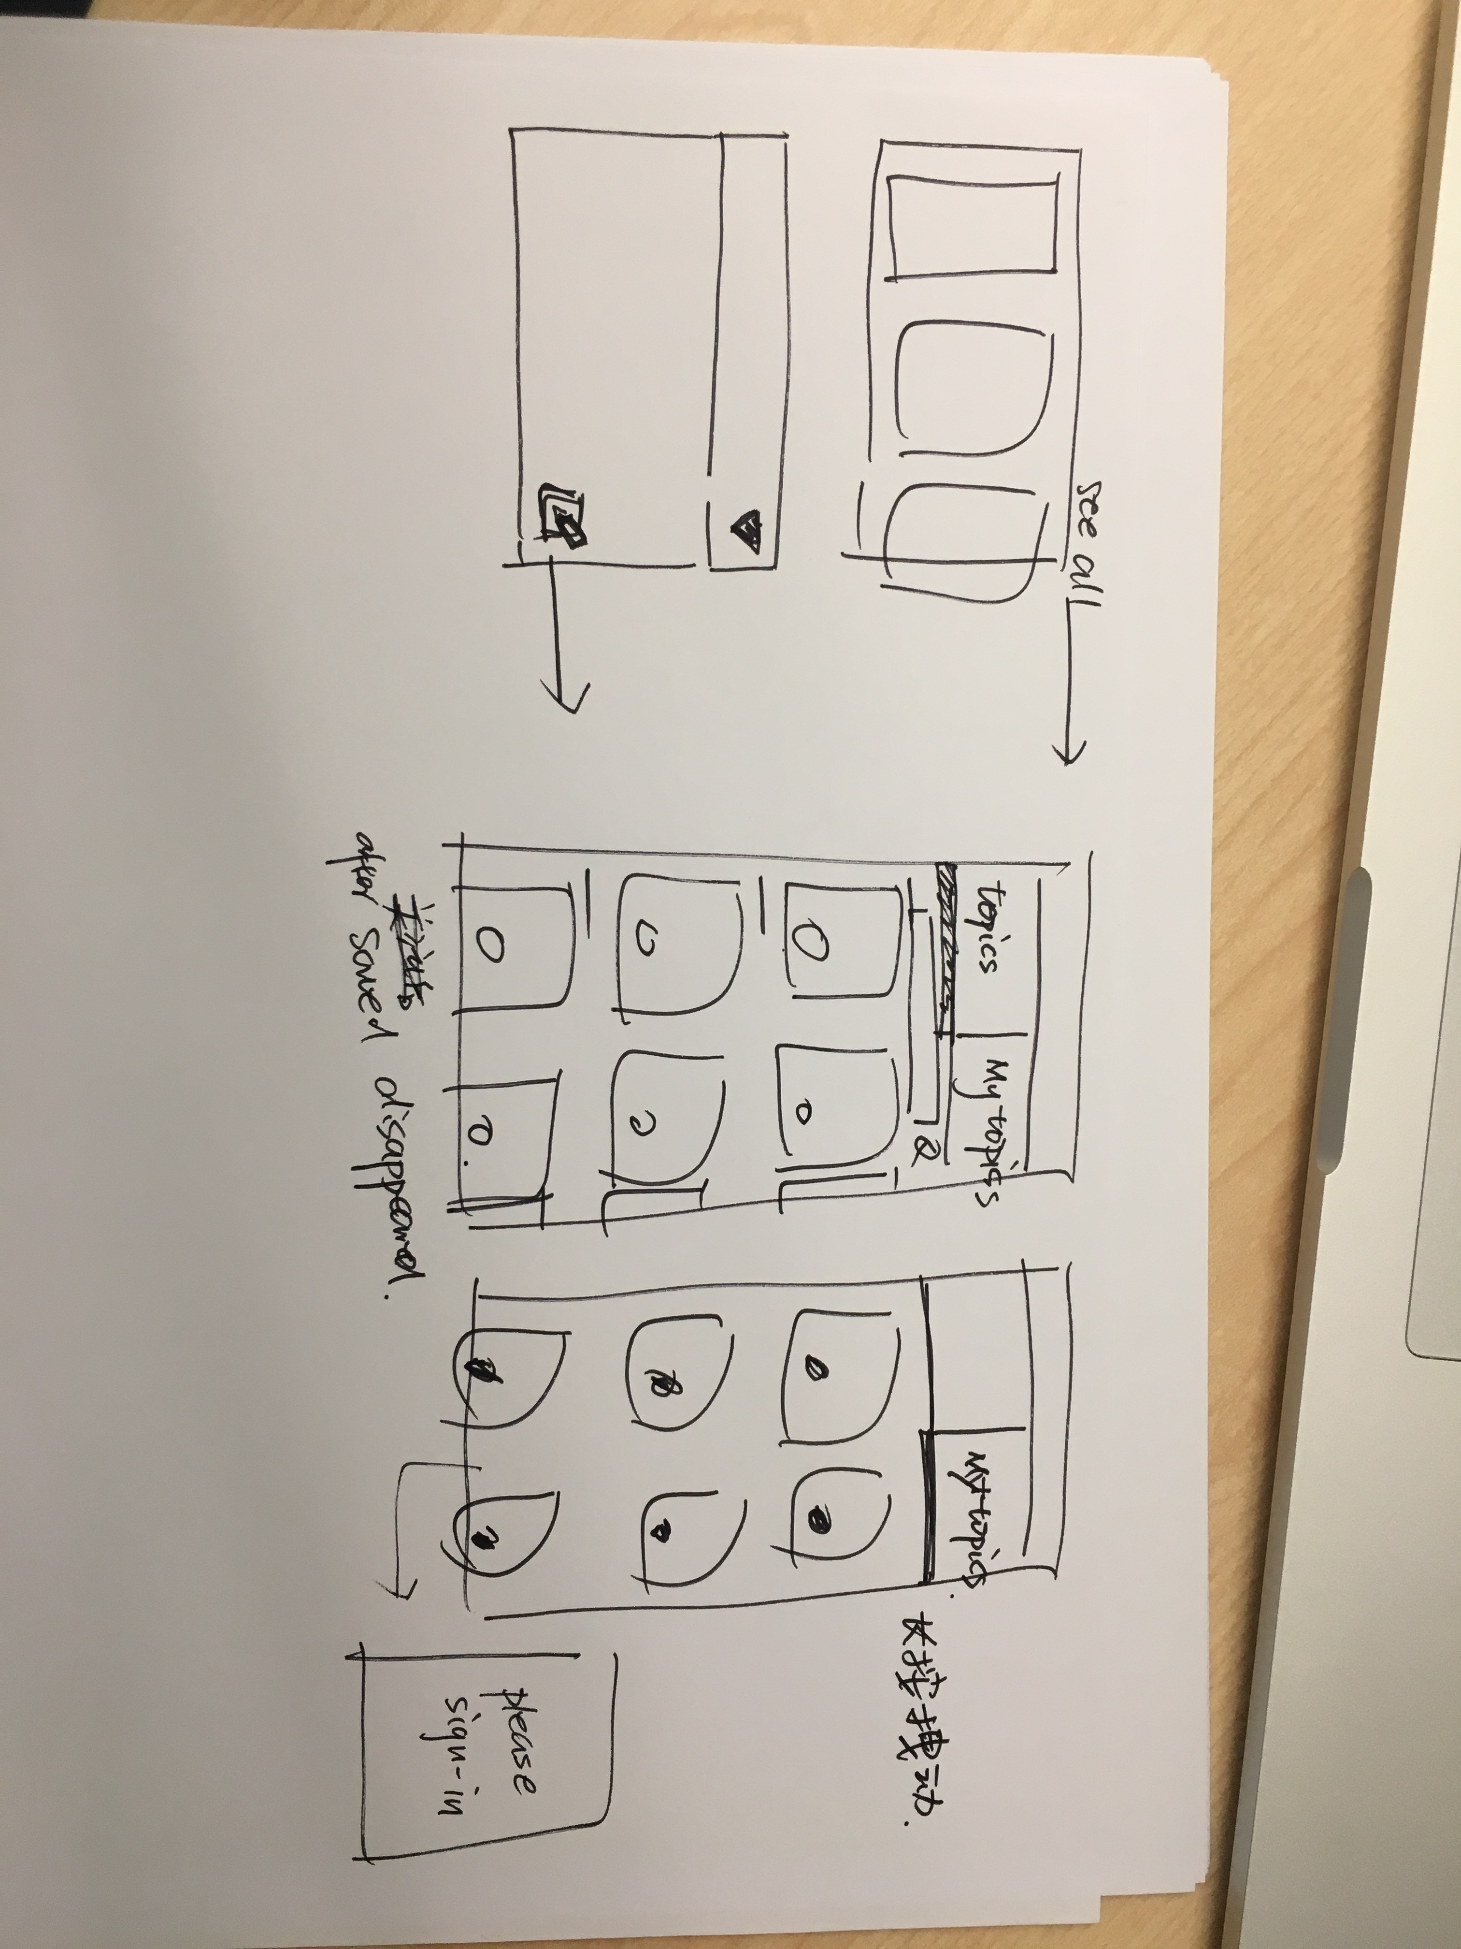

Slide 56
After followed topics, users also need to know there are some updates in that topic.

Slide 57
Lost updates

Slide 58
Staying up-to-date is the primary reason people use mobile news apps.(1)

Slide 59
Query based news
Pros
Would get real-time update
Cons
Updates would be a few

Slide 60
Know I have read all the updates since last time leave the app
Overall time period
Know the topics updates since last time leave the app
A certain topic

Slide 61
1. Know I have read all the updates since last time leave the app
Since
No need to read the repeated news again which would make users feel boring or think our product is not smart
Notify they have caught up so they could turn to read others

Slide 62
Competitors
Instagram
You’ve caught up
LinkedIn
There are new things, please engage

Slide 63
Trigger point
in the specific landing page of topics like the more than ten news on the comprehensive view page
The updates are countable

Slide 64
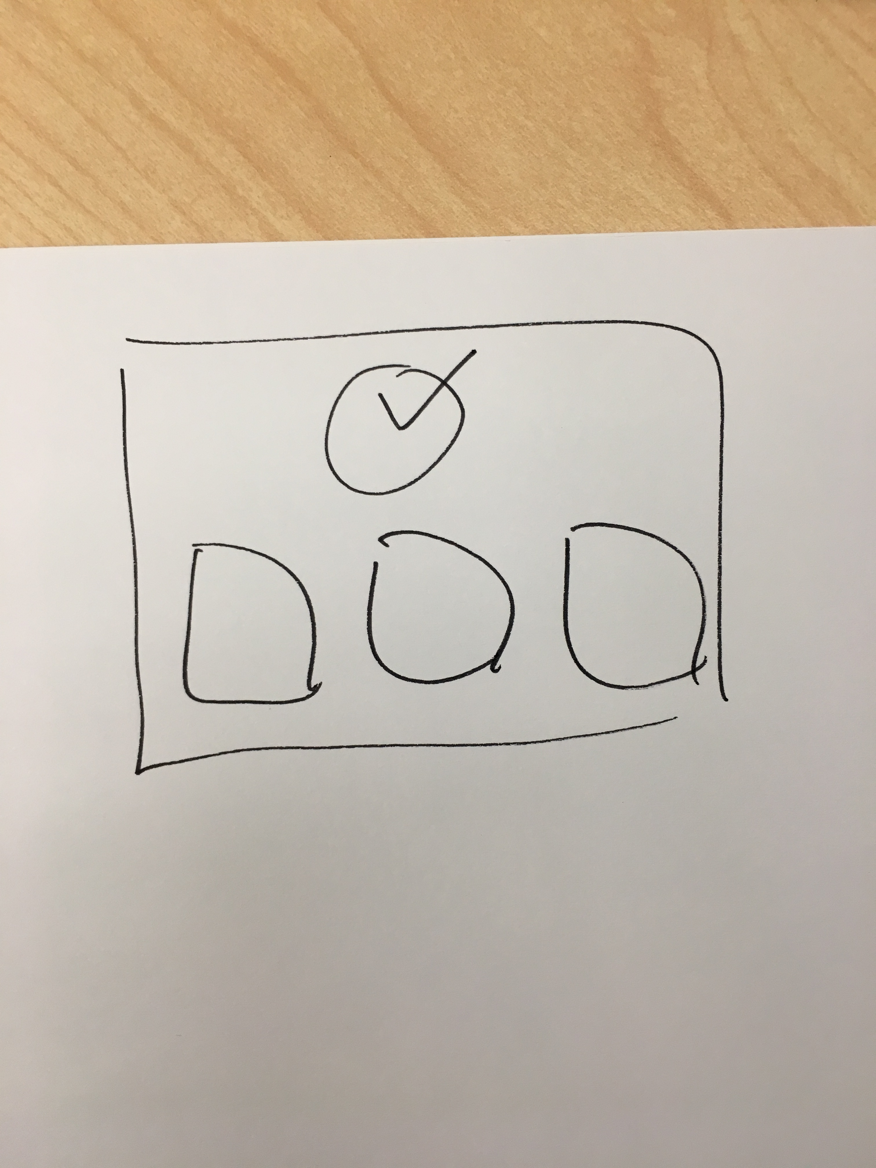
Idea 1 “caught up”

Slide 65
2. Know the topics updates since last time leave the app

Slide 66
Current solution
Users don’t enable push notifications because they feel they already get too many.(1)
To get topics updates, of course the most powerful and popular design is to push notifications. Like video platform,
But that’s not a delightful experience, and may trigger unfollow and turn off the push actions.

Slide 67
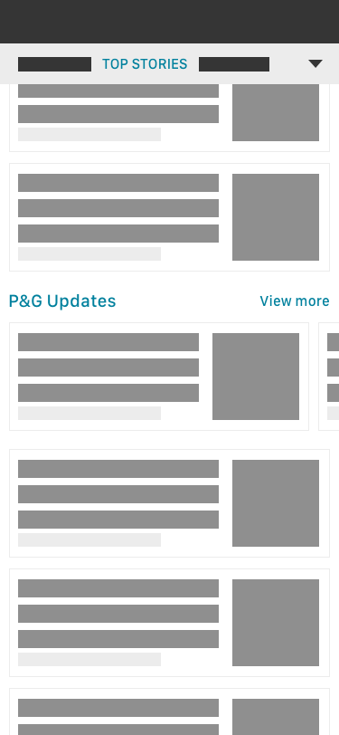
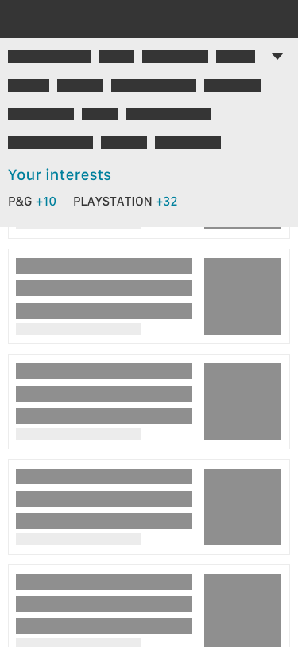
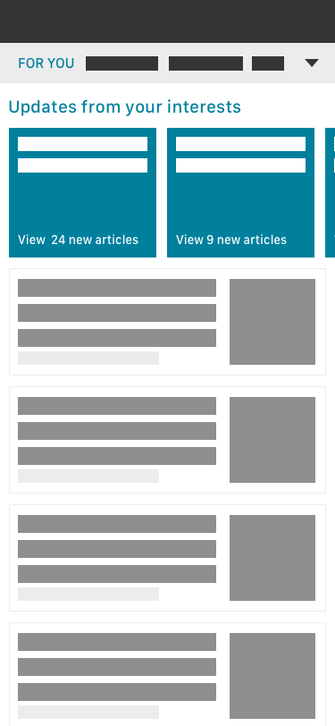
Idea 2 “following updates”

Slide 73
Appendix

Slide 74
Less effective navigation
Disorganized
Overwhelm feeling
Implication:
1. There is limited space on the homepage because of search bar, tab bar, and foldable tabs change layer
2. It feels condense on the top of the app

Slide 75
Simple source of news
We have the comprehensive view feature on the desktop.
Implication:
We should align this feature to mobile. And the interaction should adjust to mobile.
Notes:
2. Have a more comprehensive view when read a news
3. Be able to quickly find and glance at the news from their trust publishers

Slide 76
Hard to catch-up since last time read
Implication:

Slide 77
Competitors Trends Watching

Slide 78
Video stream and media
Video stream is getting a more popular news medium
So it’s valuable to know or make a metaphor from video platform design trends
Extensibility
3. Multimedia news is popular especially video stream

Slide 79
Navigation
3 Design Exploration

Slide 80
Bing current solution
A top tabs bar
Pros
Scrollable: easy to control and locate tab
Foldable: could view all tabs
Cons
Limited browsing screen size
Not customizable
Too long

Slide 81
People felt the navigation and organization were harder to follow. (3)

Slide 82
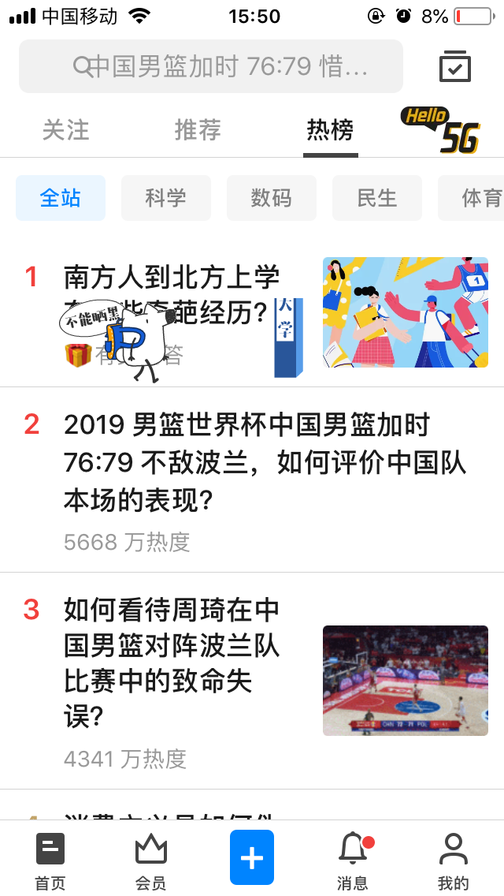
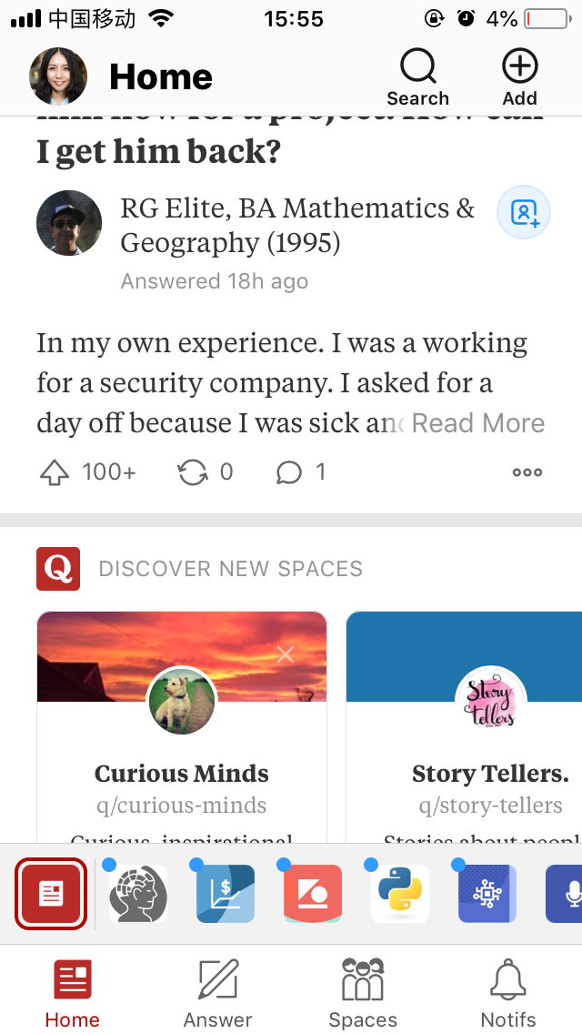
Competitors which have many categories and allow following topics
News platforms and publishers: Google News, Yahoo News, Tech Crunch
Online publishing platforms: Reuster, AP News, Bloomberg
Q&A platforms: Quora, Medium, Zhihu
Video platforms

Slide 83
People want to know why this news show on their screen if this content is curated for them.

Slide 84
User’s Motivation
Less time engage more
Comprehensive understanding
Personal taste
Design Approach
Design for efficiency
Useful mobile experience
Design for trust
Trustful news
Design for modernization
Modern style
Align to new desktop design

Slide 85
People expected being able to favorite certain topics or edit the content to display personal preferences.

Slide 86
People could not find the settings to personalized their feed, and expressed concern about the log-in requirement. (2)
People want easier, more immediate ways to personalize their feed to make it more useful and engaging. (2)
Make the personalization more visible
Another tab is not feasible,

Slide 87
Although we have good algorithm to curate and customize content for users, people don’t know which one is generate on the screen based on their interest.

Slide 88



Slide 89


Slide 90


Slide 91
Color
Topic name
Comprehensive view

Slide 92
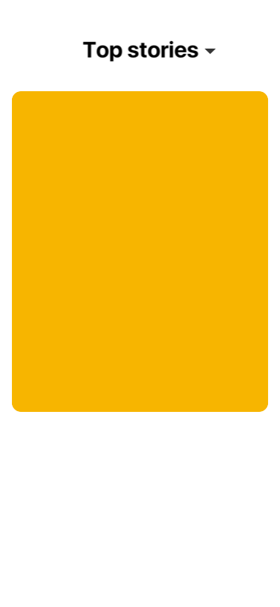

Slide 93
People did like that there were tabs for the categories at the top but felt that it was hard to scroll to see them all and would be better to see them in a different design or layout. (3)
People expected making it easier to use the tabbed navigation by changing the format so you could see all the topics at once. (3)

Slide 94
74% of mobile news app users expect real-time content updates(1)

Slide 95
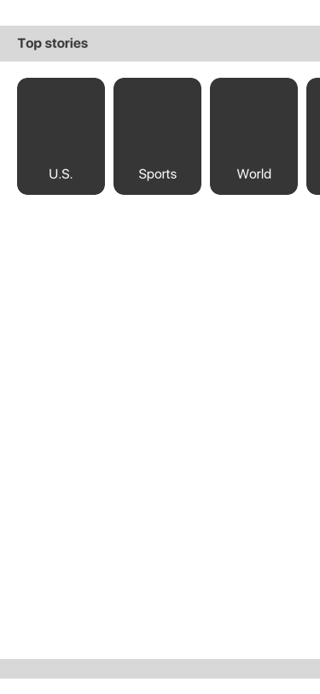

Slide 96
Comprehensive news source

Slide 97
Google is providing organized content focus more on multimedia which including video, socials and opinions.

Slide 98
People were engaged with the news vertical, but likely would not have found it or used it outside of this study(2)
Implication:
The Key is to growing habitual usage.
Solution: provide design more like a news app by amazing feature, not just like a news list embedded in a search app.

Slide 99
People expected links to other information sources and typed of content. (2)
People were also surprised not to see multiple sources for each story.(3)

Slide 100
People prefer more organized content
People felt the content in the app wasn’t well-organized .(3)
People felt that the stories included were to random and that many of them weren’t relevant or high quality.(3)

Slide 101
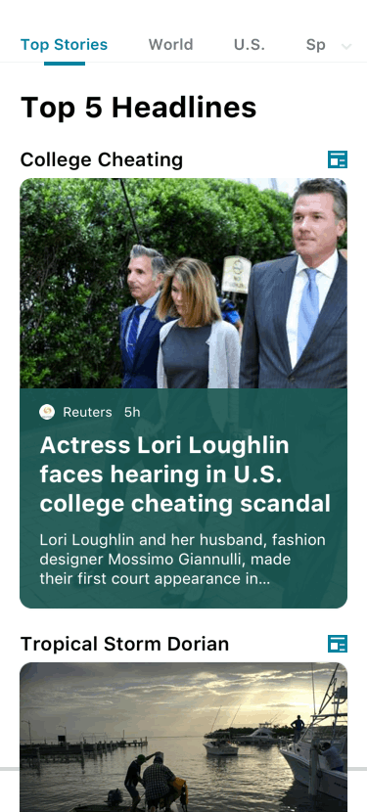

Slide 102
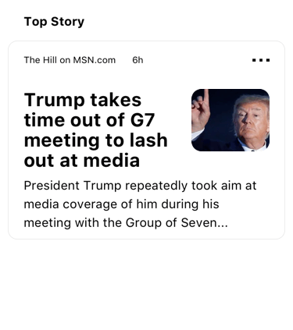

Slide 103
references
Mobile News Apps_Survey Results_June 2018_v2
https://microsoft.sharepoint.com/:p:/r/teams/BingStudios/Research/_layouts/15/Doc.aspx?sourcedoc=%7B41b644dc-bff5-402c-9168-112ef84d93c4%7D&action=default&uid=%7B41B644DC-BFF5-402C-9168-112EF84D93C4%7D&ListItemId=2561&ListId=%7B632041D8-79F7-4EBE-87A1-264EFBFC0EA4%7D&odsp=1&env=prodbubble

